Slide 1

Resume and Career Workshop
An overview of the recruiting process for entry-level software engineering and data science roles
Notes:
Richa

Slide 2


Your Consultants
Notes:
richa

Slide 3
Timeline
Overview |
Tech recruiting, over time, has gradually begun earlier and earlier.
Some applications open as early as Fall semester (banks, prop-shops, etc)
Applying early is paramount
Getting Recruited
LinkedIn, Career Fairs, Company-hosted events, Job Alerts
Jan
Feb
Mar
Apr
Online Application
Coding Challenge
Technical/Behavioral
Offer
Most companies require an online application
Referrals may lead to a slightly different process (i.e. Microsoft)
Often a ‘sanity check’ to ensure that you can code
Some companies do an HR phone screen instead
Technical interview ‘meta’ is currently Leetcode (DS/A) heavy
Other topics to know are dependent on role
The fun part!
Make sure to take time to evaluate and compare offers thoroughly
* This is an idealized timeline and is not representative
Notes:
Richa
On annual scale , start applying in August, but this is a spring semester timeline.
Referral line?
Referrals are helpful, but not necessary
Referrals can be critical to getting an edge for a position
If you want an intern to refer you however, it is critical to ask while they still have access to their company’s referral system.

Slide 4
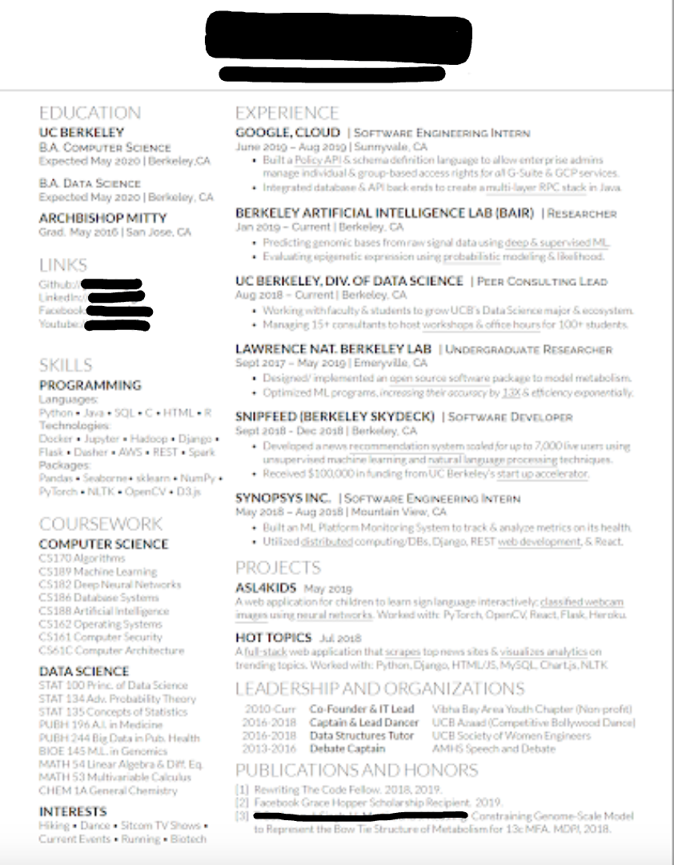
Anatomy of a Technical Resume
Resume
Overview |
High-Level
One Page
Recent and Relevant
Design for Skimmability
Breakdown:
Name/Contact info
Education / GPA
Skills
Relevant Courses
Work Experience
Personal projects
Clubs/Volunteering/Other Activities
Notes:
RIcha
-One column vs two-column

Slide 5
Technical Interviews
Overview |
Coding Pre-Screen
HackerRank Challenges or Coding Assessments
The ‘Leetcode’ section; often interviews will be centered around one or two ‘Leetcode’-like algorithm question
“In-Person” Interview.
Coding challenge
Statistics concepts
Data cleaning, modeling, visualization questions
Case study
Useful Resources
LeetCode.com
“Elements of the Programming Interview”
“Cracking the Coding Interview”
Notes:
Simran

Slide 6
What to Expect/How to Prepare
Structure of Elevator Pitch
Behavioral Interviews
Overview |
Overall fit in the Company
Research employer’s history, current events.
Write/practice position-specific elevator pitches.
Experience Based Questions
Come prepared with questions to ask the interviewer.
Brief Introduction and Academic Background
Relevant Experience
Past intern or research positions
Tailor response to the job you are applying for
Personalize It!
Your passions and interests
Why are you applying to this job
Notes:
Simran

Slide 7
STAR Approach
Sample STAR Question
Behavioral Interviews
Overview |
S - Situation
Describe situation you were in or task you needed to accomplish.
T - Task
What goal were you working towards?
A - Action
Describe the actions you took to address the situation.
R - Result
Describe the outcome of your actions and don’t be shy about taking credit for your victories!
How do you overcome any professional challenges?
S - Lay out the situation
“At my previous job, my team was responsible for ....”
T - Highlight the task
“Going through a large amounts of data, no clear guidelines on responsibilities”
A - How did you take action
“I organized a meeting … to clearly outline everyone’s tasks”
R - Results of your action
“As a result, we created an efficient system for...”
Notes:
Simran

Slide 8
Overview
Start recruiting early! Timelines vary from company to company so be alert for job postings.
Resume
Clean, concise, and relevant
Technical Interviews
Prepare for coding pre-screens as well as In-person whiteboarding and conceptual questions
Behavioral Interview
Research the company and understand what they are looking for
Master your elevator pitch
Use STAR technique to answer experience based questions
Notes:
Last Simran slide

Slide 9
Q&A!

